Slide 1

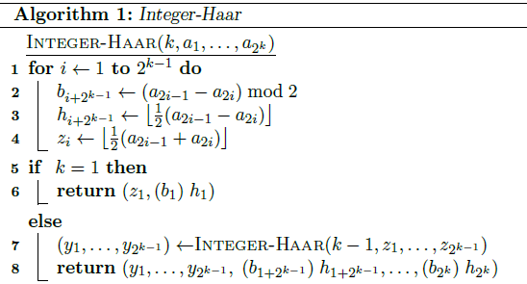
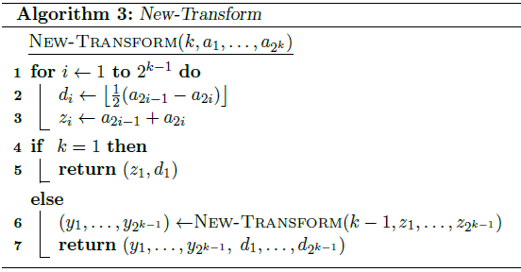
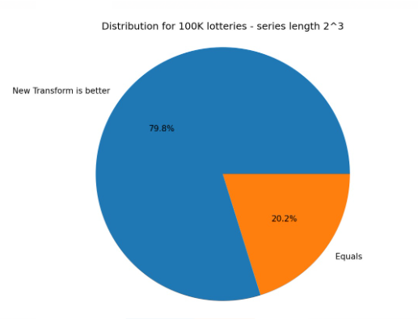

Data Compression – Comparing Haar’s Algorithms
Presenters: Liel Berniker, Noy Osi, Dvir Segal
Instructor: Prof. Dana Shapira
6
project goal:
Analyze and compare different algorithms presented in the paper “New Compression Schemes for Natural Number Sequences” , that use the Haar transform for data compression.
2. Introduction:
Data compression is the process of encoding, restructuring, or otherwise modifying data in order to reduce its size.
In our Data compression research, we specified the Haar wavelet transform, which is a simple discrete transform.
We compare the compression performance of two main Haar algorithms applied for lossless compression of integer sequences.
Haar Integer and Haar New Transform.
3. Methods and Selected Approach :
The method to compare the efficiency of the algorithms was to measure the bit size compressed message.
All the implementations were made in C++
4. Haar Integer and Haar New Transform pseudo codes:
Algorithms: | compression algorithms :
Haar integer | *Elias code 𝑪𝜹 * binary coding * unary coding.
Haar New Transform
We had various outcomes, each type of data that we use while examining the size of the compressed message gave a different answer.
In the program that creates random numbers and sorts them in an array, each time we used a different compression algorithm.
when we used the unary coding, the result shows that the Haar Integer will be more efficient in almost 100% of the attempts
when we used the binary coding, the result shows that the Haar Integer and the Haar new transform had the same bit size compressed massage for all the attempts.
But when we used the: Elias code 𝑪𝜹, the result shows that the Haar New Transform will be more efficient in almost 80% of the attempts
* in the example at the left corner, you can see the result of running the program on 100k ordered arrays, in the size of 2^3.
In 79.8% the Haar New Transform is more efficient and in the rest 20.2% they had the same bit size compressed massage
5. Solution Description (Algorithms, Modulation, Patterns, Infrastructure,
Functionality)
Visit Us
Scan QRCode for full Instructions(github)

